Slide 1
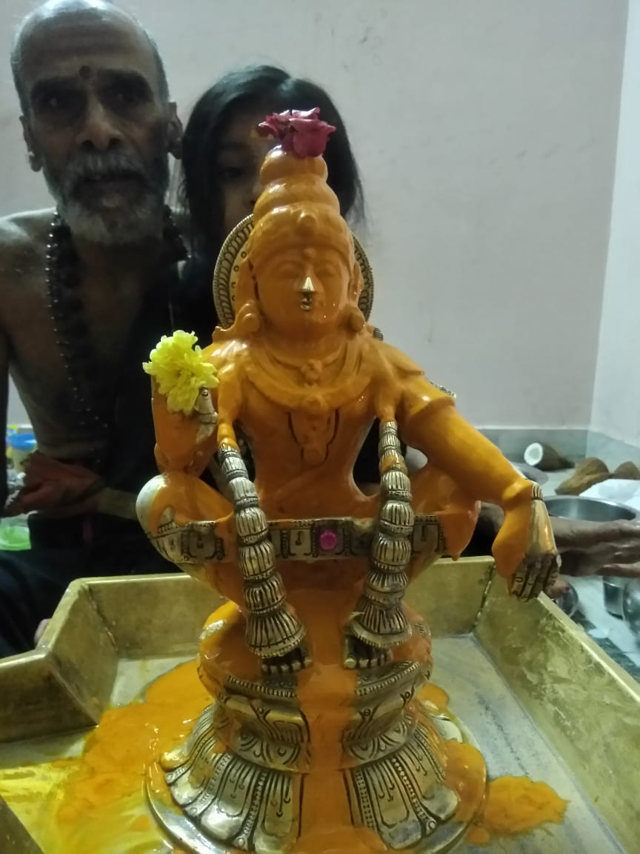
Ayyappa pooja
AYYAPPA | SWAMY | MALA | SHABARI | `MALA

Slide 2
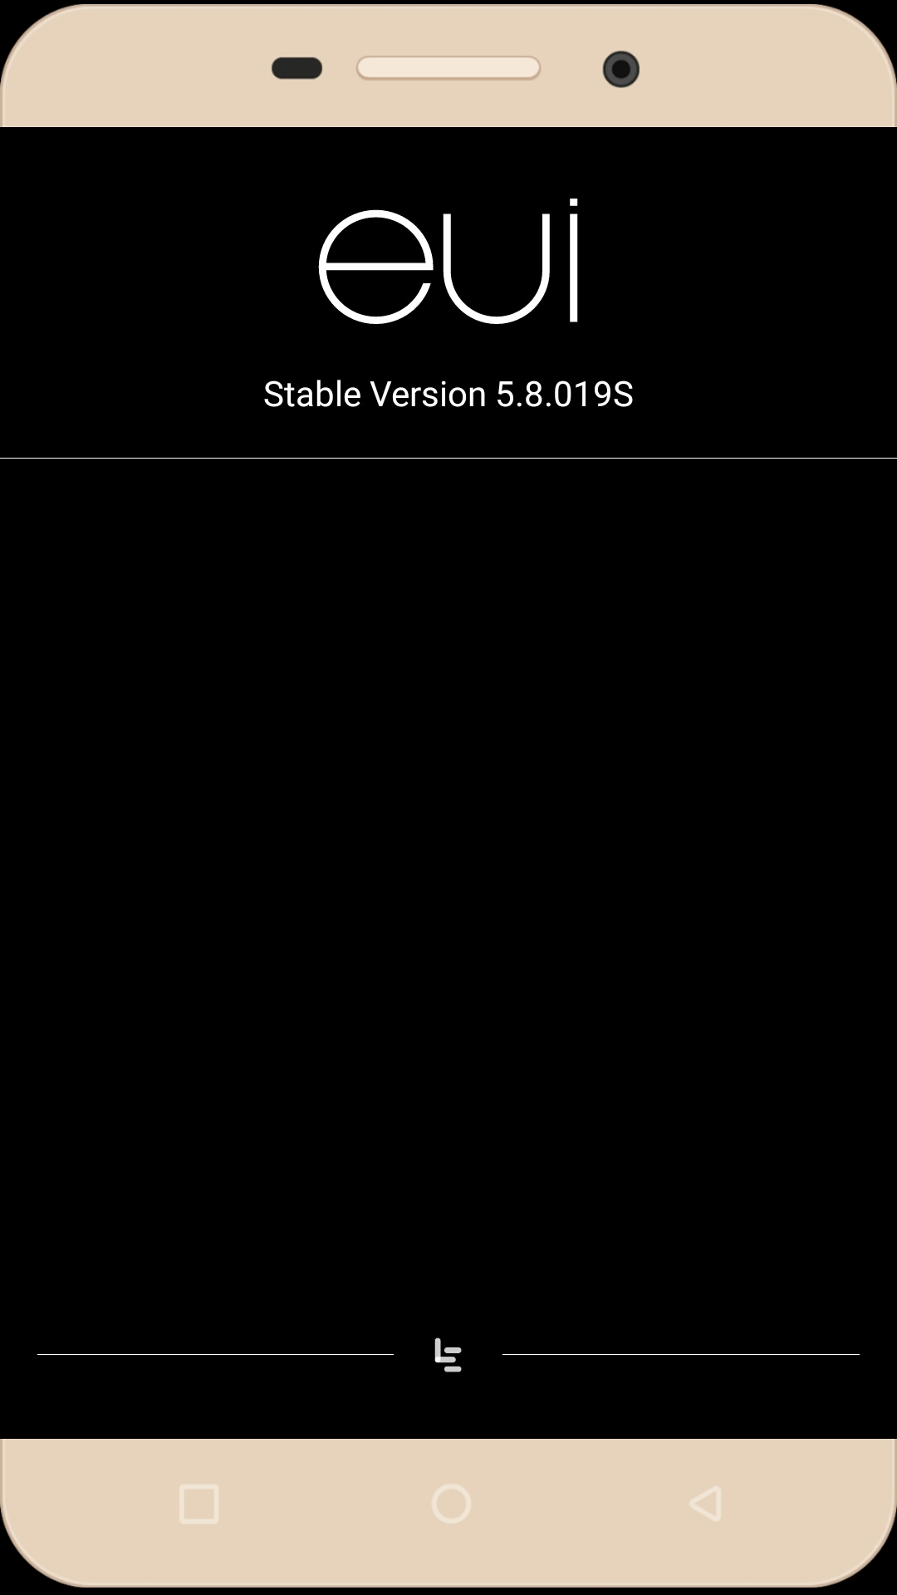
Letv 2

